Slide 1
Bell Work (10 minutes):
Solve the System
2y – 4x = 2
– 2y = 6x – 4

Slide 2
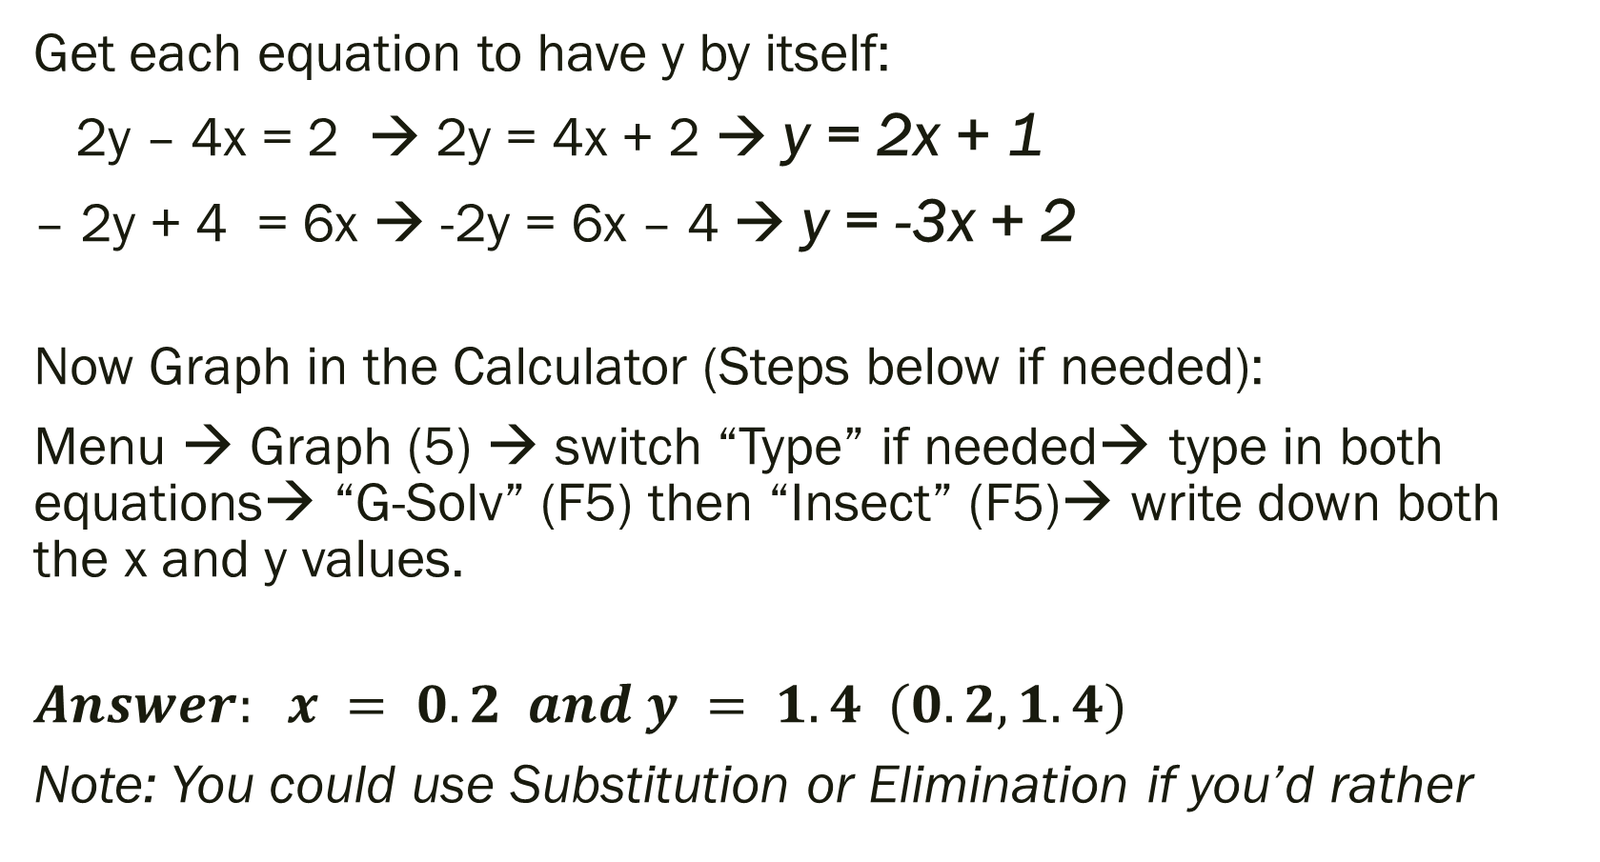
Bell Work: How to Get to the Answer
Get each equation to have y by itself:
2y – 4x = 2 → 2y = 4x + 2 → y = 2x + 1
– 2y + 4 = 6x → -2y = 6x – 4 → y = -3x + 2
Now Graph in the Calculator (Steps below if needed):
Menu → Graph (5) → switch “Type” if needed→ type in both equations→ “G-Solv” (F5) then “Insect” (F5)→ write down both the x and y values.
$$Answer: x = 0.2 and y = 1.4 (0.2, 1.4)$$
Note: You could use Substitution or Elimination if you’d rather

Slide 3
ALGEBRA 3
Day 30

Slide 4
To Do Today: -Bell Work -Get Quiz Back -Make corrections to Quiz & Finish Homework from last time -Copy Down “Things to Study” so you know exactly what is on the test and what to study -Work on the Review Assignment in small groups -Work on Missing Work (look on Infinite Campus if you are not sure what you are missing)

Slide 5
Pass Back Quiz (10 – 15 minutes)
Students who have not taken the quiz need to make arrangements to do so when I return
Those getting their quizzes back should work in small groups (or individually) to make corrections to problems that they missed so that they do not miss them again on the test

Slide 6
Finish Homework From Last Time: (15 – 20 minutes)
Page 171 #1, 9, 32, 33, 37

Slide 7
Things To Study
Level 3
-Graph a system of inequalities -Set up and Solve your own system -Solve system: Pick → Graphing, Substitution, or Elimination (2 or 3 variables)
Level 2
-Graph a system of equations -Set up and Solve your own system -Does system have 0, 1, infinite solutions (show work) -Solve system: Pick → Graphing, Substitution, or Elimination -Identify elements of a matrix -Rewrite a system as a matrix
Level 4
-Solve system of inequalities with 3 variables -Solve system equations with 3 variables
Copy into your notes!

Slide 8
Review Assignment: Answers in Back of Book
Page 184 #3 – 8 (read description to the side… just wants to know the number of solutions)
9 – 14 (solve with which ever method you prefer)
15 – 19 (solve by graphing… shade darker area)
23 – 30 (solve with which ever method you prefer)
Page 187 Remember, answers are in the back…
#1 – 7 check your work!
9 – 13
30 – 45 minutes

Slide 9
After you finish the review assignment
Continue to make corrections to the quiz if needed
Work on Missing Work (formative quiz score will be assigned after the test)
Study for the test
Work on assignments for another class
Read a book

